Slide 1

Advanced Programming CMP 102
Dr. Perihan PEHLİVANOĞLU
Biruni Univarsity
Department of Computer Engineering 2023
Spring

Slide 2
Course Plan
Introduction - Functions (Recursive functions) Arrays, ArrayList, Vector
Collections (List, Queue, Stack, Set, Map, Tree)
Streams, Files
Generics and Exceptions
Midterm Exam

Slide 3
Course Plan
Visual Programming Fundamentals Designing a Form Controls and Forms Properties of Components and Events Final Exam

Slide 4

Last Lecture
We learned about the collections. We learned List, Set, Map, Stack and Queue collections.

Slide 5
Introduction
In this course, we will learn the concepts of record, file, stream.

Slide 6
Record
With arrays, we can store uniform data. All array elements are either integers, floats, or doubles. In real life, different types of data, not uniform data, are stored in information systems. For example, a student has a name as well as a grade information. We use records to store data in files on a computer.

Slide 7
Record
Records are user-generated data types.
public record Student(String name, int grade) { }
The record keyword indicates the record definition. Each record definition must have a body { }. There is currently empty code in the body.

Slide 8
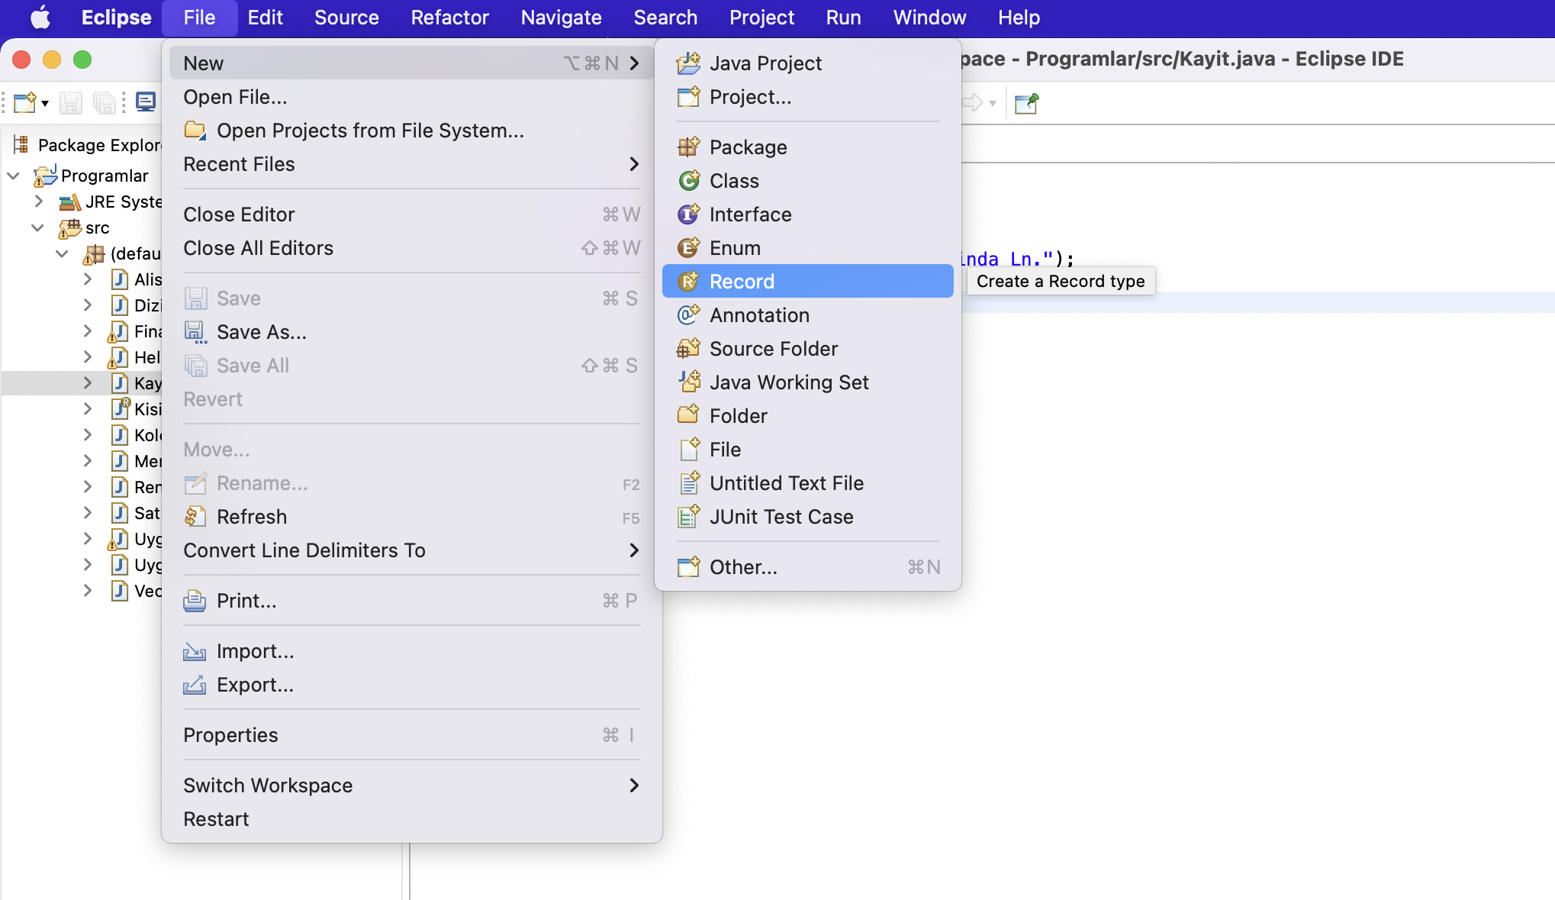
Student Record
public record Student(String name, int grade) { }

Slide 9
Example - 1
public class Enrollment
{
public static void main(String[] args)
{
Student str = new Student("Ali Bilge", 90);
System.out.println(str.name() + " " + str.grade() );
}
}

Slide 10
Example - 2
A teacher;
Name,
Surname,
Age,
Branch.
How can we create a teacher record by retrieving information from the console?

Slide 11
Teacher Record
public record Teacher(String name, String surname, int age, String branch)
{ }

Slide 12
Example - 2
import java.util.*;
public class School {
public static void main(String[] args) {
String name, surname, branch;
int age;
System.out.println("Teacher\’s name: ");
Scanner input=new Scanner(System.in);
name=input.next();
System.out.println("Teacher\'s surname: ");
surname=input.next();
System.out.println("Age of the teacher: ");
age=input.nextInt();
System.out.println("Teacher's branch: ");
branch=input.next();
Teacher tch = new Teacher (name, surname, age, branch);
System.out.println(tch);
}
}

Slide 13
Example - 3
Let’s modify the program to store 3 teacher information.

Slide 14
Öğretmen Kaydı
public record Teacher(String name, String surname, int age, String branch)
{ }

Slide 15
Example - 3
import java.util.*;
public class School {
public static void main(String[] args) {
String name, surname, branch;
int age;
ArrayList<Teacher> tchList = new ArrayList<Teacher>();
Scanner input=new Scanner(System.in);
for (int i = 1; i < 4; i++) {
System.out.println("Teacher\’s name: ");
name=input.next();
System.out.println("Teacher\'s surname: ");
surname=input.next();
System.out.println("Age of the teacher: ");
age=input.nextInt();
System.out.println("Teacher's branch: ");
branch=input.next();
Teacher tch = new Teacher (name, surname, age, branch);
tchList.add(tch);
}
for (Teacher teacherA: tchList)
System.out.println(teacherA);
}
}

Slide 16
Iterators
The Iterator is used to access the elements stored in the collection. Works like a pointer.
for (Teacher teacherA: tchList)
System.out.println(teacherA);
Iterator itr= tchList.iterator();
while(itr.hasNext())
System.out.println(itr.next());

Slide 17
EXCEPTION MANAGEMENT

Slide 18
Exceptions
Exceptions are used to manage run-time errors. The try-catch block is used.

Slide 19
Exceptions
Run-time errors
Runtime error division by 0
Quotient
Run
Let's fix it with the if statement
QuotientWithIf
Run
Let's fix it with a method.
QuotientWithMethod
Run

Slide 20
Exceptions
Now let's see the benefits by adding an exception to the program.
import java.util.Scanner;
public class ExceptionProgram {
public static int quotient(int number1, int number2) {
if (number2 == 0)
throw new ArithmeticException("Divisor cannot be zero");
return number1 / number2;
}
public static void main(String[] args) {
Scanner input = new Scanner(System.in);
// Prompt the user to enter two integers
System.out.print("Enter two integers: ");
int number1 = input.nextInt();
int number2 = input.nextInt();
try {
int result = quotient(number1, number2);
System.out.println(number1 + " / " + number2 + " is "
+ result);
}
catch (ArithmeticException ex) {
System.out.println("Exception: an integer " +
"cannot be divided by zero ");
}
System.out.println("Execution continues ...");
}
}
QuotientWithException
Run

Slide 21
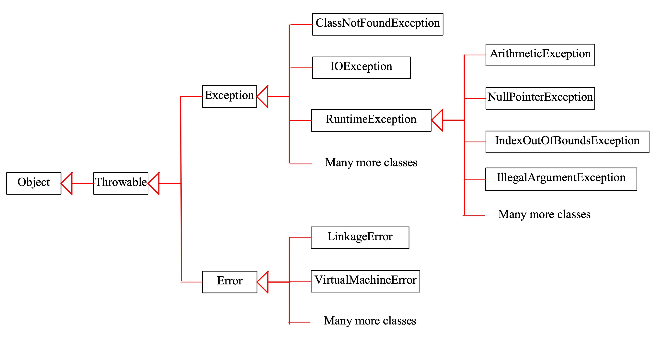
Exceptions

Slide 22
Exceptions
System errors are generated by the JVM and the Error class. These types of mistakes rarely happen, and as a Programmer you can't do much about them. You simply tell the user that he needs to terminate the program and give the error message.

Slide 23
Exceptions
An exception is caused by errors that originate in your program and outside the program. You can catch such exceptions and resolve them by your program.

Slide 24
Exceptions
The RuntimeException is caused by programming errors. Such as out-of-bounds in an array.

Slide 25
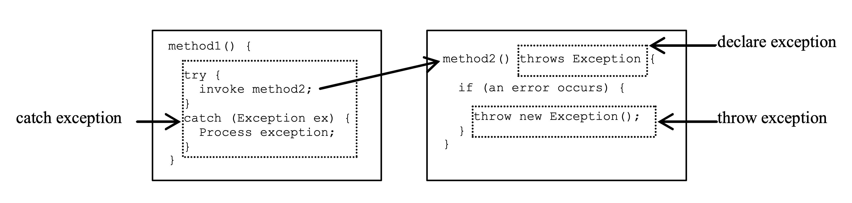
Exceptions
Exception definition and catch it.

Slide 26
Exceptions
When defining an exception, the exceptions that each method can throw are defined.
public void myMethod()
throws IOException
public void myMethod()
throws IOException, OtherException

Slide 27
Exceptions
When the program notices an error, the appropriate exception is generated and sent. This is known as throwing an exception.
throw new TheException();
TheException ex = new TheException(); throw ex

Slide 28
Exceptions
Catch the exception try {
statements; // Statements that may throw exceptions
}
catch (Exception1 exVar1) {
handler for exception1;
}
catch (Exception2 exVar2) {
handler for exception2;
}
...
catch (ExceptionN exVar3) {
handler for exceptionN;
}

Slide 29
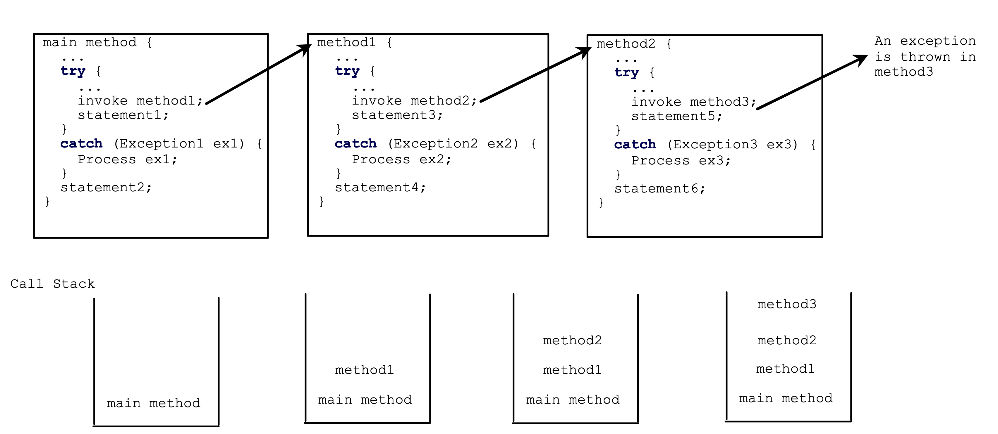
Exceptions

Slide 30
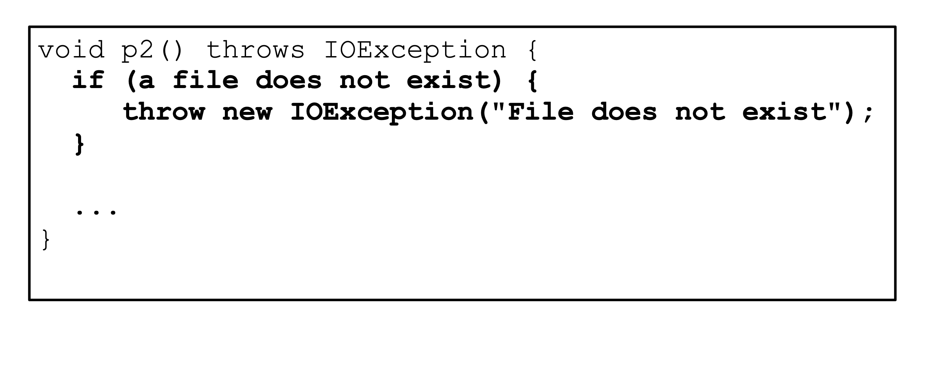
Exceptions

Slide 31
Exceptions
Finally statement
try {
statements;
}
catch(TheException ex) {
handling ex;
}
finally {
finalStatements;
}

Slide 32
Exceptions
Suppose there is no exception here.
try {
statements;
}
catch(TheException ex) {
handling ex;
}
finally {
finalStatements;
}
Next statement;

Slide 33
Exceptions
try {
statements;
}
catch(TheException ex) {
handling ex;
}
finally {
finalStatements;
}
Next statement;
This block is always executed.

Slide 34
Exceptions
try {
statements;
}
catch(TheException ex) {
handling ex;
}
finally {
finalStatements;
}
Next statement;
The next statement is executed.

Slide 35
Exceptions
try {
statement1;
statement2;
statement3;
}
catch(Exception1 ex) {
handling ex;
}
finally {
finalStatements;
}
Next statement;
Suppose an exception occurs of type Exception1 and is caused by statement2.

Slide 36
Exceptions
try {
statement1;
statement2;
statement3;
}
catch(Exception1 ex) {
handling ex;
}
finally {
finalStatements;
}
Next statement;
The exception is resolved.

Slide 37
Exceptions
try {
statement1;
statement2;
statement3;
}
catch(Exception1 ex) {
handling ex;
}
finally {
finalStatements;
}
Next statement;
The final block is always executed.

Slide 38
Exceptions
try {
statement1;
statement2;
statement3;
}
catch(Exception1 ex) {
handling ex;
}
finally {
finalStatements;
}
Next statement;
The next statement is executed.

Slide 39
Exceptions
try {
statement1;
statement2;
statement3;
}
catch(Exception1 ex) {
handling ex;
}
catch(Exception2 ex) {
handling ex;
throw ex;
}
finally {
finalStatements;
}
Next statement;
statement2 throw exception of type Exception2.

Slide 40
Exceptions
try {
statement1;
statement2;
statement3;
}
catch(Exception1 ex) {
handling ex;
}
catch(Exception2 ex) {
handling ex;
throw ex;
}
finally {
finalStatements;
}
Next statement;
Resolve an exception

Slide 41
Exceptions
The final block is executed.
try {
statement1;
statement2;
statement3;
}
catch(Exception1 ex) {
handling ex;
}
catch(Exception2 ex) {
handling ex;
throw ex;
}
finally {
finalStatements;
}
Next statement;

Slide 42
Exceptions
try {
statement1;
statement2;
statement3;
}
catch(Exception1 ex) {
handling ex;
}
catch(Exception2 ex) {
handling ex;
throw ex;
}
finally {
finalStatements;
}
Next statement;
The rethrow exception and control return to the caller.

Slide 43
Exceptions
Let there be an exception in one method. If you want the exception to be handled by the caller, you must create an exception and throw it away. If you think you can resolve the exception where the exception occurs in the method, you don't need to throw it away.

Slide 44
Exceptions
When we make something wrong, for example; Division by 0, when we enter the data type incorrectly, we encounter messages indicating why the error is the cause. After the word try, the code to be executed, and after the catch word, there is a message to be given if this code does not work. You can also create the exception. Throw is also used for this.
With or without exception, those written after the finally are executed.

Slide 45
FILES

Slide 46
Files
Programs today use files to store and read data. Some examples;
Word Processors
Database Management Systems Spreadsheets Compilers

Slide 47
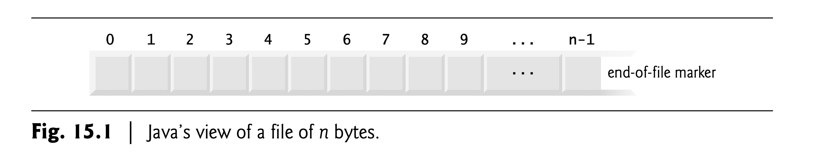
Files
Data is temporarily stored in variables and arrays. The data is deleted at the end of the program. The data is stored on the computer in the structure we call a file to be used after it is created. In our daily lives, we constantly store information in files.
The data is stored in text or binary files. In Java, files are treated as sequential streams of bytes. Operating systems have mechanisms that determine each file break with an end-of-file-marker.

Slide 48
Files
File streams accept data as bytes or characters as inputs and outputs.
Byte-based streams, input and output are in binary format. One char 2 bytes, one int 4 bytes, one double 8 bytes, etc. Character-based streams, input and output are in character format. Each character is 2 bytes. The number of bytes depends on the number of characters in a value. For example, 10 bytes for 20000 (5 characters, 2 bytes per character),
The file created with byte-based streams is called a binary file, the file created with character-based streams is called a text file. You can read the text files with the text editor, but you cannot read the binary files with the editor. These files are processed with programs.

Slide 49
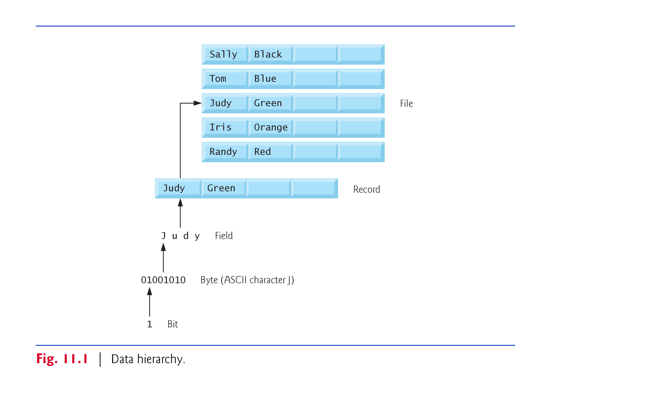
Files

Slide 50
Files
Each file ends with an end-of-file marker that indicates the end of the file. When a file is opened, a stream is associated with the file. When a program starts running, 3 types of streams are automatically opened;
standard input (System.in),
standard output (System.out) ve
standard error (System.err).
Thanks to streams, a communication (channel) is created between files and programs. In Java, the java.io.* library is used for files.

Slide 51
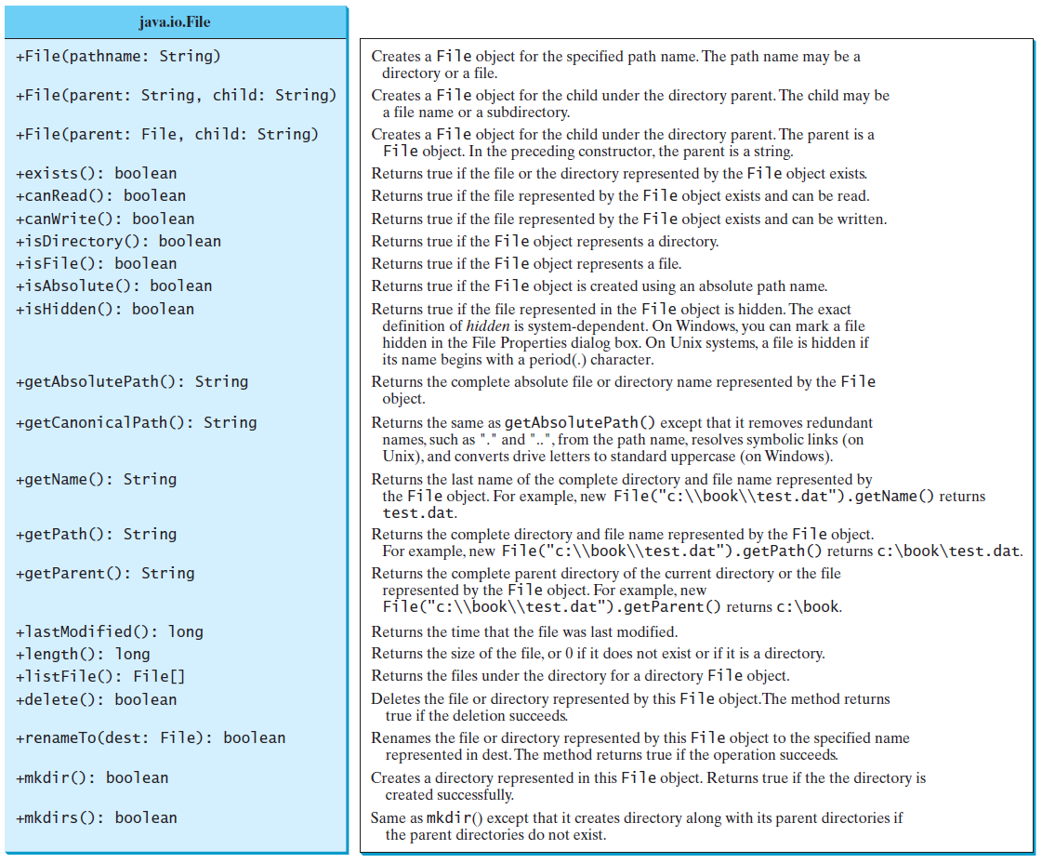
Files

Slide 52
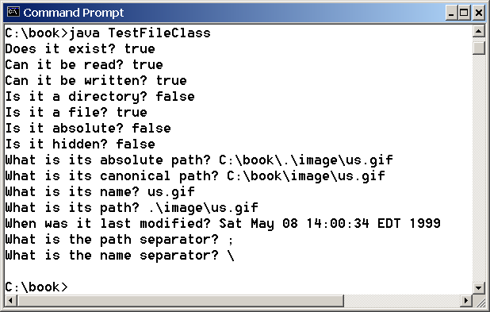
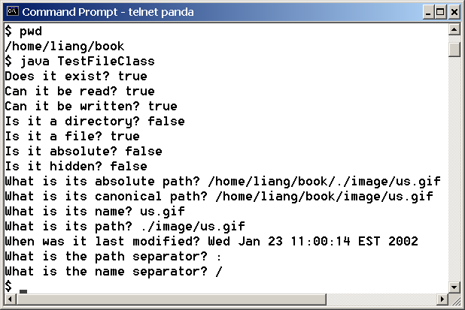
Files
The example program is related to a file and its properties.
TestFileClass
Run

Slide 53
Files
First of all, let's do sequential-access with text files. Let's deal with Scanner and PrintWriter. When processing files the operations are performed in the following order:
Open file Write to file
Close file

Slide 54
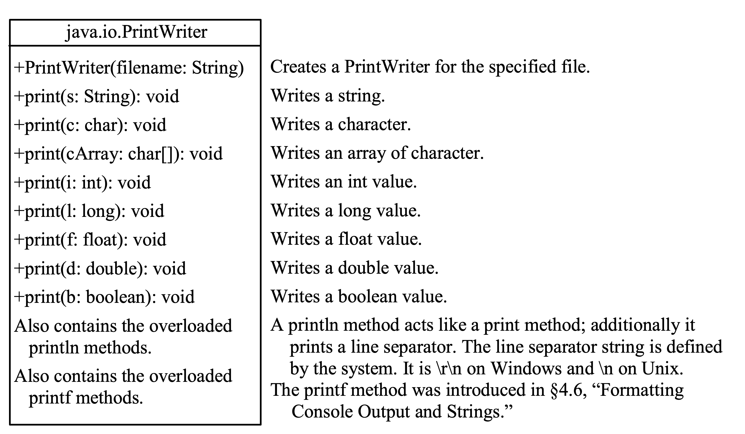
Writing to a File with PrintWriter

Slide 55
Files
import java.util.*;
import java.io.*;
public class FileProgram {
public static void main(String[] args) throws java.io.IOException {
java.io.File dosya = new java.io.File("dosyalar.txt");
java.io.PrintWriter output = new java.io.PrintWriter(dosya);
output.println("Ali");
output.println("Ayse");
output.close();
}
}

Slide 56
Writing to a File with PrintWriter
public class example1 {
public static void main(String[] args) throws java.io.IOException {
java.io.File file = new java.io.File("scores.txt");
if (file.exists()) {
System.out.println("File already exists");
System.exit(0);
}
// Create a file
java.io.PrintWriter output = new java.io.PrintWriter(file);
// Write formatted output to the file
output.print("John T Smith ");
output.println(90);
output.print("Eric K Jones ");
output.println(85);
// Close the file
output.close();
}
}
WriteData
Run

Slide 57
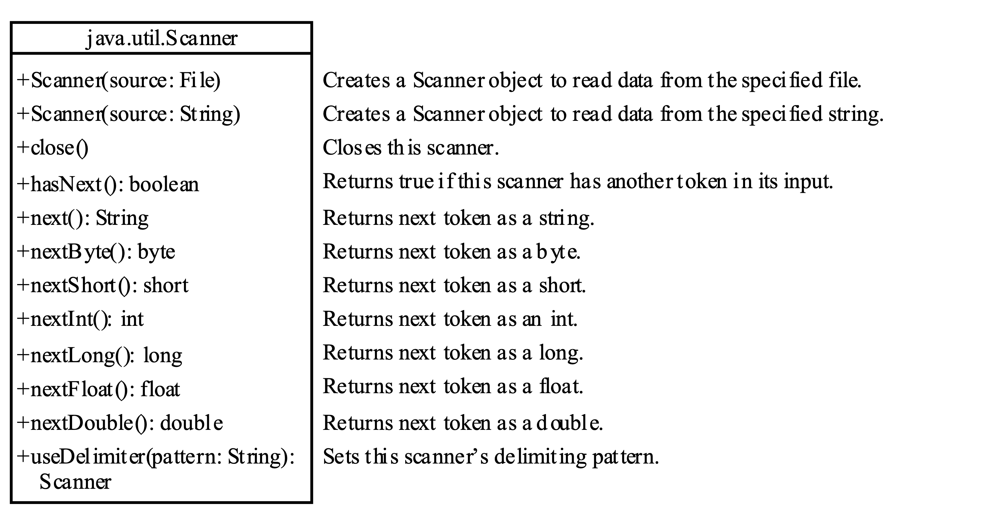
Reading a File with Scanner

Slide 58
Reading from a File with Scanner
import java.util.Scanner;
public class example1 {
public static void main(String[] args) throws Exception {
// Create a File instance
java.io.File file = new java.io.File("scores.txt");
// Create a Scanner for the file
Scanner input = new Scanner(file);
// Read data from a file
while (input.hasNext()) {
String firstName = input.next();
String mi = input.next();
String lastName = input.next();
int score = input.nextInt();
System.out.println(
firstName + " " + mi + " " + lastName + " " + score);
}
// Close the file
input.close();
}
}
ReadData
Run

Slide 59
Replacing Text in a File with Another Text
Replacement program
ReplaceText
Run

Slide 60
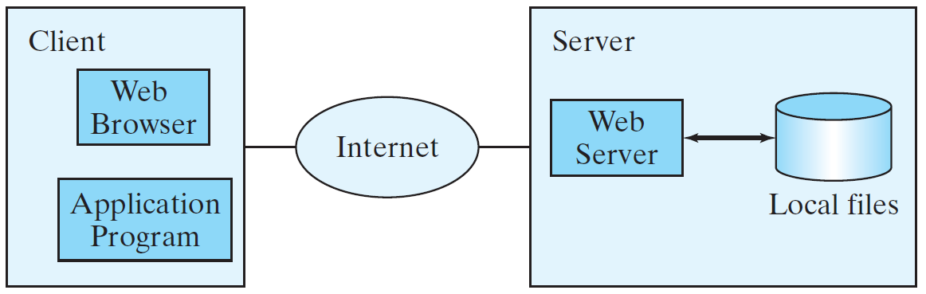
Read Data from the Web
You can read data from a file as well as read data on the web.

Slide 61
Read Data from the Web
URL url = new URL("www.google.com/index.html");
Once the URL object is created, you can use the openStream() method with the Scanner object.
Scanner input = new Scanner(url.openStream());
ReadFileFromURL
Run

Slide 62
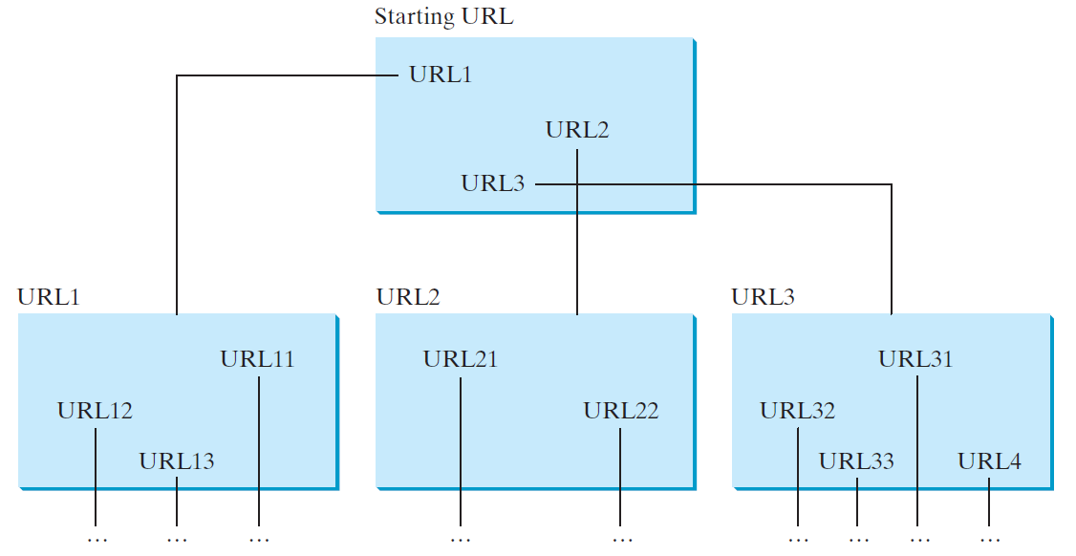
Web Crawler
You can create a webcrawler.
WebCrawler
Run

Slide 63

Homework - 1
Create a record of book with title, author, year
Store 5 book information with ArrayList. Write this information in the file. Read the information from the file, write it on the console.

Slide 64
Next Lecture
The next lesson, we will continue.

Slide 65
Programming Session
ArrayList
Files
we will carry out applications.

Slide 66
Summary
As a result, this week we learned how to create records. We wrote the information we kept in memory to the file to make it permanent, we read it. We'll continue next week. Come prepared. Study from textbook.

